Slide 1

Feature Engineering for Loan Default Prediction

Slide 2
Project Overview
This project improves loan default prediction accuracy for financial institutions. We use advanced data preparation and feature engineering to build a robust and reliable predictive model.
Objective
Approach
Key Outcomes
Develop an accurate machine learning model for loan default prediction.
Utilize meticulous data preparation, advanced feature engineering, and state-of-the-art modeling techniques, ensuring models are built on clean and relevant information.
Achieve enhanced risk assessment, reduced financial losses, and improved profitability for institutions.

Slide 3
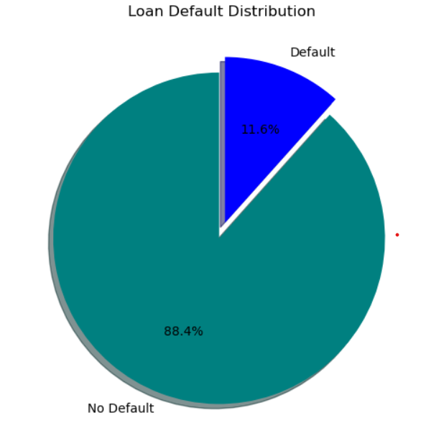
Dataset Overview and Initial Insights
Our analysis uses a dataset with 17 features, such as Age, Income, LoanAmount, and CreditScore, with Default (0 or 1) as the target variable. Initial exploration is key to understanding its structure.
Dataset Features
Age
Income
LoanAmount
CreditScore
EmploymentType
Education
Mortgage
Dependents
Default (Target)
...
The initial preview using df.head() and pd.read_csv("Loan_default.csv") confirmed its structure, revealing immediate needs for preprocessing.
A significant imbalance was observed, with 88% of loans not defaulting and 12% defaulting—a common challenge in financial datasets.

Slide 4


Tech Stack & Key Tools
Our project leveraged a robust suite of tools, from core programming languages to specialized libraries, ensuring efficient development and accurate model performance.
Python
Pandas & NumPy
The primary programming language for all data manipulation, analysis, and machine learning model development tasks.
Essential libraries used for powerful data structuring, cleaning, and advanced numerical operations throughout the project.
Scikit-learn
Matplotlib
A comprehensive machine learning library, pivotal for implementing algorithms like Logistic Regression and Random Forest.
A powerful data visualization library used for creating static, animated, and interactive plots and charts to gain insights from data.

Slide 5
Data Preparation: Handling Missing Values
Clean data is the foundation of reliable models. We systematically addressed missing values to ensure data integrity and prevent model bias.
Identifying Missingness
Strategic Column Dropping
Imputation for Remaining Gaps
Used df.isnull().mean() to quickly assess the percentage of missing values per column.
Columns with over 50% missing data were dropped to avoid introducing excessive noise or imputation errors.
Numerical missing values were filled with the median, while categorical missing values were imputed with the mode.
df[col].fillna(df[col].median())
df[col].fillna(df[col].mode()[0])
This rigorous process ensures that the dataset is robust and ready for subsequent feature engineering. Let's dive into the data and preparation steps.

Slide 6



Feature Engineering: Creating and Transforming Features
Feature engineering transforms raw data into a format that better represents the underlying problem to the predictive models, enhancing their performance.
Loan-to-Income Ratio
Categorical Encoding
Numerical Scaling
Created loan_to_income_ratio as LoanAmount / (Income + 1) to assess a borrower's capacity to repay the loan relative to their income.
Converted all categorical columns (e.g., Education, EmploymentType) into numerical representations using astype('category').cat.codes.
Applied StandardScaler to numerical features, normalizing them to a standard range to prevent features with larger values from dominating the model.
These steps ensure that our data is not only clean but also optimized for machine learning algorithms, enabling more accurate predictions.

Slide 7



Model Training: Splitting Data and Algorithms
With our data prepared and engineered, the next critical step is to split it for training and testing, and then to train our chosen models.
Data Splitting
Logistic Regression
Random Forest Classifier
The dataset was divided into an 80% training set and a 20% testing set using train_test_split(X, y, train_size=0.8, random_state=0). This ensures our model is evaluated on unseen data.
A fundamental linear model, Logistic Regression, was trained to establish a baseline for prediction accuracy: log_reg.fit(X_train, y_train).
A more robust ensemble model, Random Forest, was trained with n_estimators=200 to capture complex non-linear relationships: rf_model.fit(X_train, y_train).
These models provide a comprehensive approach to evaluating the loan default prediction problem. Now, let's evaluate their performance.

Slide 8
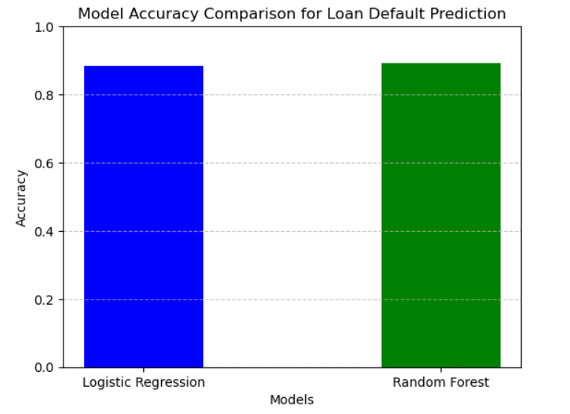






Model Evaluation and Results
Evaluating our models is crucial to understanding their effectiveness and identifying areas for improvement, especially with imbalanced datasets.
Accuracy Score
Confusion Matrix
Both Logistic Regression and Random Forest achieved approximately 88% accuracy. While seemingly high, this metric can be misleading with imbalanced data.
Revealed strong performance in predicting non-defaults but low recall for actual defaults, indicating a challenge in correctly identifying the minority class.
Precision, Recall, F1-Score
Highlighted the trade-offs between false positives and false negatives, confirming the struggle to accurately predict defaults due to class imbalance.
These results underscore the importance of specialized techniques for imbalanced datasets, which could further improve the model's ability to identify high-risk loans.

Slide 9
